Slide 1
UNIT-I

Slide 2
What is Hacking?
Gaining access to a system that you are not supposed to have access is considered as hacking. For example: login into an email account that is not supposed to have access, gaining access to a remote computer that you are not supposed to have access, reading information that you are not supposed to able to read is considered as hacking. There are a large number of ways to hack a system.
What is Ethical hacking?
Ethical hacking is also known as White hat Hacking or Penetration Testing. Ethical hacking involves an authorized attempt to gain unauthorized access to a computer system or data.
Ethical hacking is used to improve the security of the systems and networks by fixing the vulnerability found while testing.
Ethical hackers improve the security posture of an organization.
Ethical hackers use the same tools, tricks, and techniques that malicious hackers used, but with the permission of the authorized person.
The purpose of ethical hacking is to improve the security and to defend the systems from attacks by malicious users.

Slide 3
Advantages of Hacking
There are various advantages of hacking:
It is used to recover the lost of information, especially when you lost your password.
It is used to perform penetration testing to increase the security of the computer and network.
It is used to test how good security is on your network.
Understanding the Purpose of Ethical Hacking
Ethical hackers are usually security professionals or network penetration testers who use their hacking skills and toolsets for defensive and protective purposes.
. Any computer professional can learn the skills of ethical hacking.
Hackers can be divided into three groups:
White Hats Good guys, ethical hackers
Black Hats Bad guys, malicious hackers
Gray Hats Good or bad hacker; depends on the situation

Slide 4
White hats are the good guys, the ethical hackers who use their hacking skills for defensive purposes. White-hat hackers are usually security professionals with knowledge of hacking and the hacker toolset and who use this knowledge to locate weaknesses and implement countermeasures.
White-hat hackers are prime candidates for the exam.
White hats are those who hack with permission from the data owner. It is critical to get permission prior to beginning any hacking activity.
They focus on security and protecting IT system. White hat hacking is legal.
Black Hats
Black hats are the bad guys: the malicious hackers or crackers who use their skills for illegal or malicious purposes.
They break into or otherwise violate the system integrity of remote systems, with malicious intent. Having gained unauthorized access, black-hat hackers destroy vital data, deny legitimate users service, and just cause problems for their targets.
Black-hat hackers and crackers can easily be differentiated from white-hat hackers because their actions are malicious.

Slide 5
Here, the organization doesn’t allow the user to test it. They unethically enter inside the website and steal data from the admin panel or manipulate the data. They only focus on themselves and the advantages they will get from the personal data for personal financial gain.
One of the most common methods used by black hat hackers is phishing, which involves tricking people into providing credentials or personal information via fake websites or emails. Once they have access to this information, they can use it to gain unauthorized access to computer systems and networks.
Black-hat Hackers are also known as an Unethical Hacker or a Security Cracker. These people hack the system illegally to steal money or to achieve their own illegal goals.
They find banks or other companies with weak security and steal money or credit card information. They can also modify or destroy the data as well. Black hat hacking is illegal.

Slide 6
Gray Hats
Gray hats are hackers who may work offensively or defensively, depending on the situation. This is the dividing line between hacker and cracker.
Gray hat Hackers are Hybrid between Black hat Hackers and White hat hackers. They can hack any system even if they don't have permission to test the security of the system but they will never steal money or damage the system.
In most cases, they tell the administrator of that system. But they are also illegal because they test the security of the system that they do not have permission to test. Grey hat hacking is sometimes acted legally and sometimes not.
They sometimes access to the data and violates the law.
But never have the same intention as Black hat hackers, they often operate for the common good.
The main difference is that they exploit vulnerability publicly whereas white hat hackers do it privately for the company.
One criticism of Grey Hat hackers is that their actions can still cause harm. Even if they do not steal or damage data, their unauthorized access to computer systems can still disrupt operations and cause financial losses for companies.
Additionally, there is always the risk that a Grey Hat hacker will accidentally cause damage while attempting to identify vulnerabilities.

Slide 7
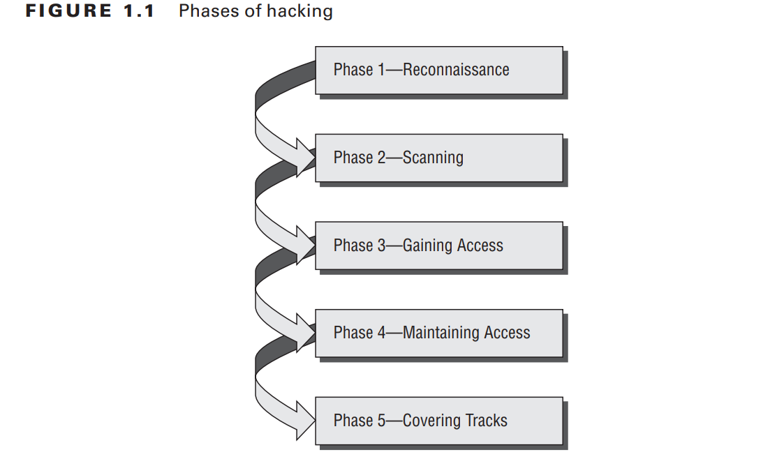
The Phases of Ethical Hacking
The process of ethical hacking can be broken down into five distinct phases.
An ethical hacker follows processes similar to those of a malicious hacker. The steps to gain and maintain entry into a computer system are similar no matter what the hacker’s intentions are.
Figure 1.1 illustrates the five phases that hackers generally follow in hacking a computer system

Slide 8
Phase 1: Passive and Active Reconnaissance
Passive reconnaissance involves gathering information about a potential target without the targeted individual’s or company’s Knowledge.
Passive reconnaissance can be as simple as watching a building to identify what time employees enter the building and when they leave. However, most reconnaissance is done sitting in front of a computer.
When hackers are looking for information on a potential target, they commonly run an Internet search on an individual or company to gain information.
I’m sure many of you have performed the same search on your own name or a potential employer, or just to gather information on a topic. This process when used to gather information regarding a TOE is generally called information gathering.
Social engineering and dumpster diving are also considered passive information-gathering methods.
Sniffing the network is another means of passive reconnaissance and can yield useful information such as IP address ranges, naming conventions, hidden servers or networks, and other available services on the system or network.
Sniffing network traffic is similar to building monitoring: a hacker watches the flow of data to see what time certain transactions take place and where the traffic is going.
Sniffing tools are simple and easy to use and yield a great deal of valuable information.

Slide 9
Active reconnaissance involves probing the network to discover individual hosts, IP addresses, and services on the network. This process involves more risk of detection than passive reconnaissance and is sometimes called rattling the doorknobs.
Active reconnaissance can give a hacker an indication of security measures in place (is the front door locked?), but the process also increases the chance of being caught or at least raising suspicion.
Many software tools that perform active reconnaissance can be traced back to the computer that is running the tools, thus increasing the chance of detection for the hacker.
Both passive and active reconnaissance can lead to the discovery of useful information to use in an attack.
For example, it’s usually easy to find the type of web server and the operating system (OS) version number that a company is using. This information may enable a hacker to find a vulnerability in that OS version and exploit the vulnerability to gain more access.

Slide 10
Phase 2: Scanning
Scanning involves taking the information discovered during reconnaissance and using it to examine the network. Tools that a hacker may employ during the scanning phase include
Dialers
Port scanners
Internet Control Message Protocol (ICMP) scanners
Ping sweeps
Network mappers
Simple Network Management Protocol (SNMP) sweepers
Vulnerability scanners
Hackers are seeking any information that can help them perpetrate an attack on a target, such as the following:
Computer names
Operating system (OS)
Installed software
IP addresses
User accounts

Slide 11
Phase 3: Gaining Access
Phase 3 is when the real hacking takes place. Vulnerabilities exposed during the reconnaissance and scanning phase are now exploited to gain access to the target system. The hacking attack can be delivered to the target system via a local area network (LAN), either wired or wireless; local access to a PC; the Internet; or offline.
Examples include stackbased buffer overflows, denial of service, and session hijacking.
Gaining access is known in the hacker world as owning the system because once a system has been hacked, the hacker has control and can use that system as they wish .
In this phase, the hacker designs the blueprint of the network of the target with the help of data collected during Phase 1 and Phase 2.
Phase 4: Maintaining Access
Once a hacker has gained access to a target system, they want to keep that access for future exploitation and attacks.
Sometimes, hackers harden the system from other hackers or security personnel by securing their exclusive access with backdoors, rootkits, and Trojans.
Once the hacker owns the system, they can use it as a base to launch additional attacks. In this case, the owned system is sometimes referred to as a zombie system.

Slide 12
Phase 5: Covering Tracks
Once hackers have been able to gain and maintain access, they cover their tracks to avoid detection by security personnel, to continue to use the owned system, to remove evidence of hacking, or to avoid legal action.
Hackers try to remove all traces of the attack, such as log files or intrusion detection system (IDS) alarms.
Examples of activities during this phase of the attack include
Steganography
Using a tunneling protocol
Altering log files

Slide 13
What Do Ethical Hackers Do?
Ethical hackers are motivated by different reasons, but their purpose is usually the same as that of crackers: they’re trying to determine what an intruder can see on a targeted network or system, and what the hacker can do with that information. This process of testing the security of a system or network is known as a penetration test, or pen test.
Understanding the importance of security
Whether perpetuated by an ethical hacker or malicious hacker, all attacks are an attempt to breach computer system security.
Security consists of four basic elements:
Confidentiality
Authenticity
Integrity
Availability
A hacker’s goal is to exploit vulnerabilities in a system or network to find a weakness in one or more of the four elements of security.
For example, in performing a denial-of-service (DoS) attack, a hacker attacks the availability elements of systems and networks.

Slide 14
Computer Security: The protection afforded to an automated information system in order to attain the applicable objectives of preserving the integrity, availability, and confidentiality of information system resources (includes hardware, software, firmware, information/data, and telecommunications).
Confidentiality is the protection of information in the system so that an unauthorized person cannot access it. This type of protection is most important in military and government organizations that need to keep plans and capabilities secret from enemies. However, it can also be useful to businesses that need to protect their proprietary trade secrets from competitors or prevent unauthorized persons from accessing the company’s sensitive information (e.g., legal, personal, or medical information).
Integrity is the protection of system data from intentional or accidental unauthorized changes. The challenges of the security program are to ensure that data is maintained in the state that is expected by the users.
Authenticity: The property of being genuine and being able to be verified and trusted; confidence in the validity of a transmission, a message, or message originator. This means verifying that users are who they say they are and that each input arriving at the system came from a trusted source.
Availability: Assures that systems work promptly and service is not denied to authorized users.

Slide 15
Information theft, such as stealing passwords or other data as it travels in cleartext across trusted networks, is a confidentiality attack, because it allows someone other than the intended recipient to gain access to the data. This theft isn’t limited to data on network servers. Laptops, disks, and backup tapes are all at risk.
Bit-flipping attacks are considered integrity attacks because the data may have been tampered with in transit or at rest on computer systems; therefore, system administrators are unable to verify the data is as the sender intended it.
A bit-flipping attack is an attack on a cryptographic cipher: the attacker changes the cipher text in such a way as to result in a predictable change of the plain text, although the attacker doesn’t learn the plain text itself. This type of attack isn’t directed against the cipher but against a message or series of messages.
In the extreme, this can become a DoS attack against all messages on a particular channel using that cipher. The attack is especially dangerous when the attacker knows the format of the message.
When a bit-flipping attack is applied to digital signatures, the attacker may be able to change a promissory note stating “I owe you $10.00” into one stating “I owe you $10,000.”

Slide 16
MAC address spoofing is an authentication attack because it allows an unauthorized device to connect to the network when Media Access Control (MAC) filtering is in place, such as on a wireless network. By spoofing the MAC address of a legitimate wireless station, an intruder can take on that station’s identity and use the network.
Ethical Hacking Terminology
Threat : An environment or situation that could lead to a potential breach of security. Ethical hackers look for and prioritize threats when performing a security analysis. Malicious hackers and their use of software and hacking techniques are themselves threats to an organization’s information security.
Exploit A piece of software or technology that takes advantage of a bug, glitch, or vulnerability, leading to unauthorized access, privilege escalation, or denial of service on a computer system.
Malicious hackers are looking for exploits in computer systems to open the door to an initial attack.
Most exploits are small strings of computer code that, when executed on a system, expose vulnerability.
Experienced hackers create their own exploits, but it is not necessary to have any programming skills to be an ethical hacker as many hacking software programs have ready-made exploits that can be launched against a computer system or network.
An exploit is a defined way to breach the security of an IT system through a vulnerability

Slide 17
Vulnerability The existence of a software flaw, logic design, or implementation error that can lead to an unexpected and undesirable event executing bad or damaging instructions to the system. Exploit code is written to target a vulnerability and cause a fault in the system in order to retrieve valuable data.
Target of Evaluation (TOE) A system, program, or network that is the subject of a security analysis or attack. Ethical hackers are usually concerned with high-value TOEs, systems that contain sensitive information such as account numbers, passwords, Social Security numbers, or other confidential data.
It is the goal of the ethical hacker to test hacking tools against the high-value TOEs to determine the vulnerabilities and patch them to protect against exploits and exposure of sensitive data.
Attack An attack occurs when a system is compromised based on a vulnerability. Many attacks are perpetuated via an exploit. Ethical hackers use tools to find systems that may be vulnerable to an exploit because of the operating system, network configuration, or applications installed on the systems, and to prevent an attack.

Slide 18
Protect Yourself: What and what not to do?
Do not post information on social media that can be related to challenging questions
Use passwords that cannot be broken by brute force or guessing.
Consider 2-factor authentication when possible.
Be careful of password requests emails. Services like Heroku, Gmail, and others will not request to type in passwords for additional promotion or service.
Verify the source of contact.
Before clicking a link, investigate it.
Always scan a file and never click on batch files.
Always see the background services that are running on your device and never rely on others’ devices.
Be sure to have an antivirus installed and set root passwords for installation.
Log out of sessions and clean the cache.

